Slide 1



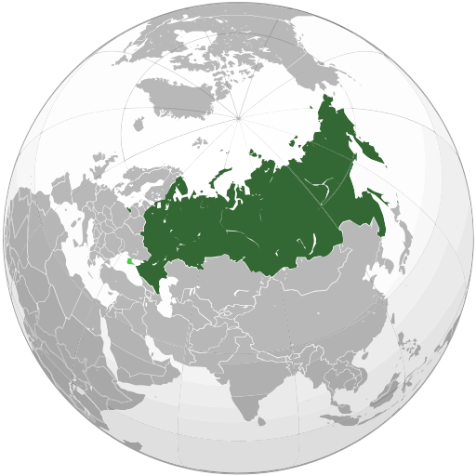
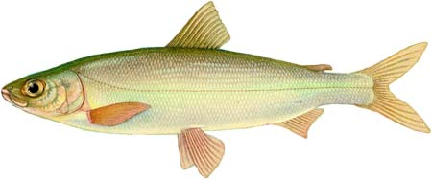

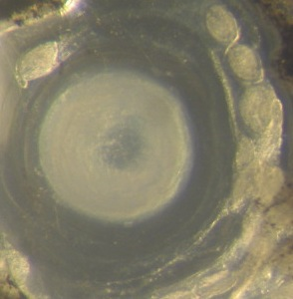
EFFECT OF EYE FLUKES (Trematoda, Diplostomatidae) UPON ACTIVITY OF GUT DIGESTIVE ENZYMES IN BAIKAL OMUL (Coregonus migratorius Georgi, 1775)
Mikhail M. Solovyev*¹, Olga T. Rusinek²
¹Institute of Systematics and Ecology of Animals Siberian Branch of Russian Academy of Sciences, Novosibirsk, Russia
²Baikal Museum of ISC SB RAS, Listvyanka, Irkutsk region, Russia, *e-mail: yarmak85@mail.ru
INTRODUCTION
Table 1.
RESULTS
Indeed, the fry feed on the different type of small invertebrates as zooplankton, larvae of chironomids, oligacheta and etc. Also, the main alkaline protease is chymotrypsin because the level of activity is in three times higher than trypsin.
The influence of different groups of parasites on digestion of vertebrates (including fish) is not well studied that primarily results from complicated sampling and selecting of an appropriate model for such investigations. However, some fresh water fish species show the influence of parasites on certain parameters of digestive system (activity and specter of digestive enzymes, content of protein and glycogen in alimentary canal and liver and etc.) (Izvekova et al., 2005; 2006). The influences of parasites localized in eyes can influence on activity of digestive enzymes in host’s gut. It is very well known that eye flukes can decrease the ability of fish to find food and, thus, alter the feeding activity and behavior (Rusinek et al., 2007).
The goal of the present study is to determine the activity of main digestive enzymes in intestine of omul at different level of intensity of invasion by eye flukes.
Enzyme |  | Mean | SE | (Unit)
Pancreatic | Amylase | 1.08 | 0.14 | mU
 | Non specific lipase | 5.1 | 0.46 | mU
 | Trypsin | 27.04 | 2.92 | mU
 | Chymotrypsin | 89.9 | 9.6 | mU
 | Total alkaline proteases | 2.06 | 0.22 | mU
Brash-border | Alkaline phosphatase | 0.7 | 0.05 | U
 | Aminopeptidase | 0.54 | 0.04 | mU
 | Maltase | 7.5 | 0.5 | mU
SAMPLING AND AREA OF STUDY
The differences in activity of studied enzymes between fry with low (less than 10 metacercaria per one fish) and high (more than 10 metacercaria per one fish) intensity of invasion were insignificant (One Way ANOVA at p ˂ 0.05) for all enzymes except amylase. The activity of amylase was significantly (Levene test, p=0.023) higher for fry with high intensity of invasion (Fig. 1).
Fig. 1.
The present study was focused on the fry fish (yearlings, 0+) Coregonus migratorius (Georgi, 1775) with a standard length of body (SL) as 40-50 mm (51 individuals) which were grown in Rezun’ka lake of Bolshaya Rechka fish farm before releasing into lake Baikal. The samples were collected in July, 2013. Fish were captured with a landing net (2 mm mesh size). The intensity and extensiveness of invasion of Diplostomatidae metacercaria in eyes of fry fish omul were determined on the binocular MBS 10 (Russia) via the compression method.
*
Table 2.
Intensity of invasion
The extracting of digestive enzymes and determination of their activity (total activity of alkaline protease, trypsin, chymotrypsin, alpha amylase, lipase, N-aminopeptidase, maltase, alkaline phosphotase, leucine-alanine peptidase) were done following Gisbert et al. (2008). The concentration of the dissolved protein was determined by Bradford’s method (Bradford, 1976).
Enzymes | R Spearman
Alpha-amylase | 0.03
Lipase | 0.15
Trypsin | 0.14
Chymotrypsin | 0.15
Alkaline proteases | 0.12
Alkaline phosphatase | -0.36
Maltase | -0.26
Aminopeptidase | -0.23
Correlation analysis revealed the significant negative correlation (p<0.05) between maltase, alkaline phosphatase (brash border enzymes) and intensity of invasion whereas for all other enzymes the correlation was insignificant (Table 2).
For determination of relations between activity of digestive enzymes and intensity of invasion One Way ANOVA and parametric correlation analysis were applied.
DISCUSSION
Class: Pisces
Order: Salmoniformes
Family: Salmonidae
Genus: Coregonus
Species: C. migratorius
Class: Trematoda
Order: Strigeidida
Family: Diplostomatidae
Genus: Diplostomum
Species: D. spathaceum
Our data well correlate with the results obtained from studies of fry fish of the Baltic salmon when they suffer an acute form of parasite disease (diplostomosis). Those studies also demonstrate the change in the activity of digestive hydrolases (phosphotase activity) (Konradi-Kondrashov, Vismanis, 1979). Such a correlation between the parasite invasion intensity (that is not directly related to digestive tract disease of fish) and activity of digestive enzymes was earlier reported as well (Kurovskaya, 1984; Solov’ev et al., 2010).
The results obtained shed the light both on the influence of eye parasites on digestive processes of Baikal omul fry fish and features of functioning of host-parasite systems as a whole.
RESULTS
The intensity of invasion of D. spathaceum in eyes of omul was 10.3±0.8 at min and max of invasion – 0 and 25 individuals per fry consequently. The extensiveness was 93.7%.
The specific activity of studied enzymes is presented in Table 1. The activity of alpha-amylase is lower than activity of alkaline proteases. Then, the relation of A/P (amylase/proteases) for omul fry is ˂ 1 and correspond to carnivorous fish.
1 mm
The study was supported by the Russian Foundation for Basic Research, project № 13-04-00270 А.
Eye infected by D. spathaceum

